Slide 1
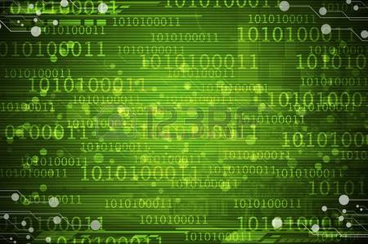
INTRODUCTION
WORLD BANK, NEW DELHI 23-24 March, 2017
AJAY K BASU
akbasu48@gmail.com

Slide 2
INTRODUCTION TO DIGITAL ELECTRONICS
Digital systems represent information using a binary system, where data can assume one of only two possible values: zero or one.
The system can be implemented with a few basic elements. We will represent numbers by semiconductor switch. The switch can be operated at extremely high speed – say one billion times per second.

Slide 3
Bit, Nibble and Byte
The switch stores binary information. Let us assume the state is 0 if the switch is off and 1 if it is on.
Bit, Nibble and byte:
Bit: Binary digit, can represent 0 or 1
Nibble: 4 bits, can represent 0 (0000) to 15 (1111)
Byte: 8 bits, can represent 0 (00000000) to 255 (11111111)

Slide 4
Number System
Number representation
Number System | Base | No. of bits/ digit | Range/digit
Binary | 2 | 1 | 0-1
Octal | 8 | 3 | 0-7
Hexadecimal | 16 | 4 | 0-15
 |  |  | 10-15 in hexadecimal are represented by A-F

Slide 5
Number System
345 in decimal = 5x10⁰ + 4x10¹ + 3x10²
Similarly, 345 in octal = 5x8⁰ + 4x8¹ + 3x8²
= 5 + 32 + 192
= 229
345 in hexadecimal = 5x16⁰ + 4x16¹ + 3x16²
= 5 + 64 + 768
= 837

Slide 6
Program
Numbers can be stored in a register and can be manipulated by a sequence of instructions called program.
For example, to add 3 & 4, a program may look like:
Put 3 in register A
Put 4 in register B
Add content of registers A & B
Store result in register A

Slide 7
Registers
8-bit register can hold numbers 0-255
00000000 to 1111111 or 0 to 2⁸ – 1
16-bit register can hold numbers 0-65535
or 0 to 2¹⁶ – 1
N-bit register can hold numbers 0 to 2^{N} – 1

Slide 8
Memory
Memory is usually arranged in bytes.
Memory capacity is expressed in
KB or Kilobytes (1024 bytes), approx 10³ bytes
MB or Megabytes (1024 KB), approx 10⁶ bytes
GB or Gigabytes (1024 MB), approx 10⁹ bytes
TB or Terrabytes (1024 GB), approx 10¹² bytes

Slide 9
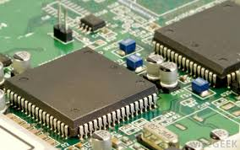
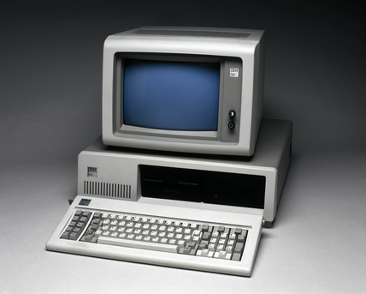
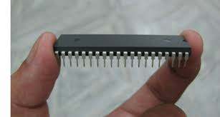
Introduction to computers/microcontrollers

Slide 10
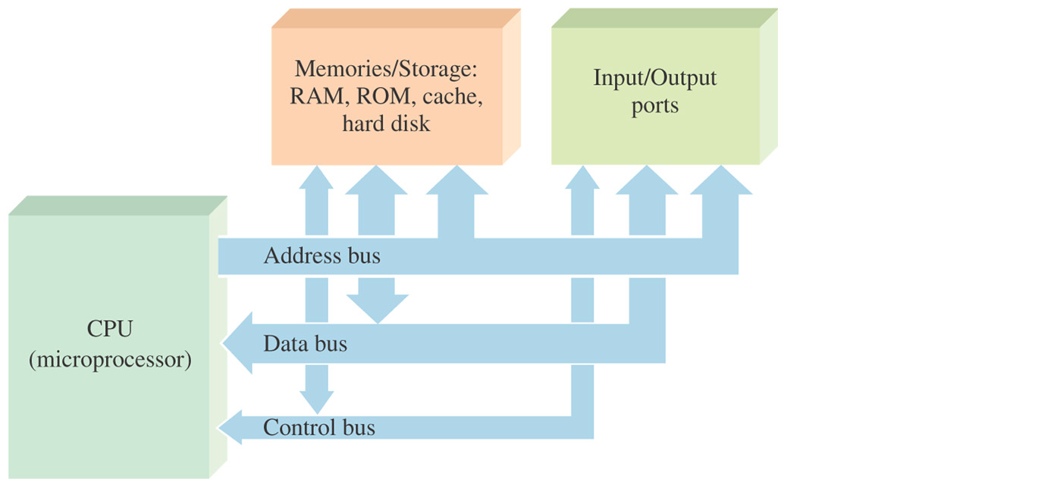
Basic computer block diagram

Slide 11
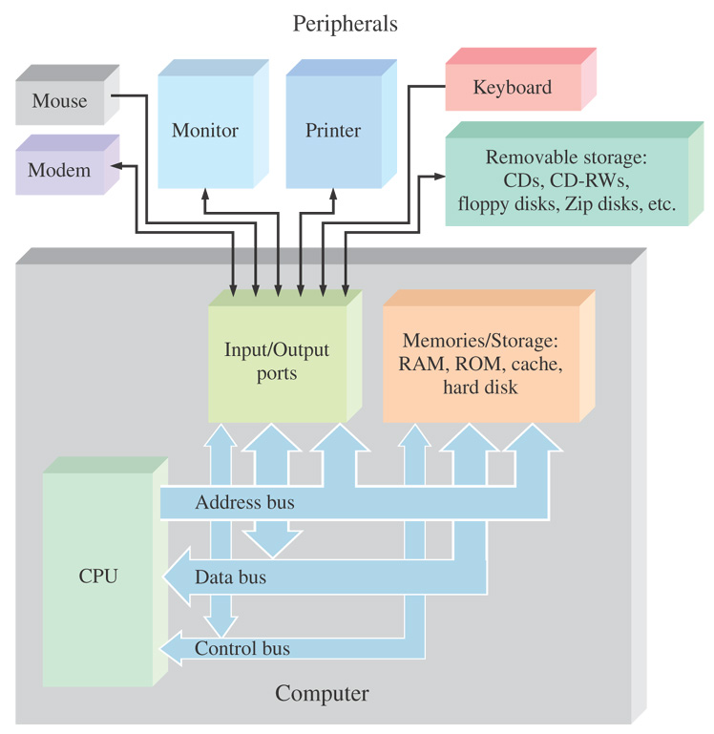
TYPICAL COMPUTER SYSTEM

Slide 12
Harvard vs. Princeton Architecture
Many years ago, in the late 1940's, the US Government asked Harvard and Princeton universities to come up with a computer architecture to be used in computing distances of Naval artillery shell for defense applications.
Princeton suggested computer architecture with a single memory interface. It is also known as Von Neumann architecture after the name of the chief scientist of the project in Princeton University John Von Neumann (1903 - 1957 Born in Budapest, Hungary).
Harvard suggested a computer with two different memory interfaces, one for the data / variables and the other for program / instructions. Although Princeton architecture was accepted for simplicity and ease of implementation, Harvard architecture became popular later, due to the parallelism of instruction execution.

Slide 13
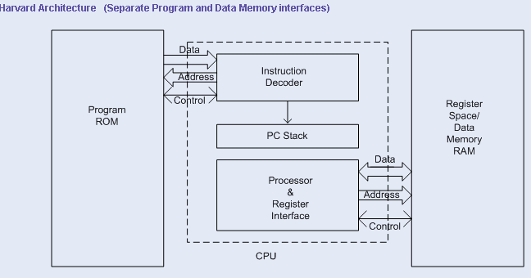
HARVARD ARCHITECTURE

Slide 14
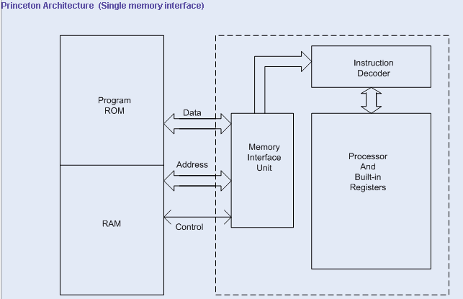
PRINCETON ARCHITECTURE

Slide 15
INSTRUCTION SET ARCHITECTURE
Instruction set
Word Length
Memory Addressing modes
Registers
Data types

Slide 16
INSTRUCTION SET
Complex Instruction Set
- Supports high level programming constructs
- Single instruction procedure calls, loop control, and
complex addressing modes allowing data structure and
array accesses to be combined into single instructions
- Enhances code density
- Smaller program size
- Fewer memory access
Reduced Instruction Set
- Supports smaller and highly optimized instruction set
- Load/Store approach
- Most microcontrollers use RISC architecture
- Examples: ARM, AVR, SPARC, K-Computer
Minimal Instruction Set
One Instruction Set
Very Long Instruction Set

Slide 17
INSTRUCTION TYPE
Data Handling and Memory operations
- Load Immediate - Set a register to a fixed constant value
- Load/Store - move data from a memory location to a register, or
vice versa
- Read/Write data from hardware devices
Arithmetic and Logic operations
- Add, Subtract, Multiply or divide the values of two registers, - Place the result in a register
- Set one or more Condition Code in a Status Register
- Bitwise operation (AND/OR/NOT etc.) in a pair of registers
- Comparison of two values in registers (A> or < or =B)

Slide 18
INSTRUCTION TYPE - 2
Control flow operations
- Branch to another location in the program
- Conditional Branch - to another location if a certain condition holds
- indirect branch to another location, while saving the location of the next
instruction as a point to return to (a call)
Complex Instructions
- Combination of many simple Instructions
- Examples:
- Saving many registers on the stack at once
- Moving large blocks of memory
- Complex/floating point arithmetic (sine/cosine/ square root etc.)

Slide 19
DATA TYPE
Integer 100
Floating Point 100.123
Boolean 1/0
Character a / A / 4
String “ Good morning
Everybody”

Slide 20
COMPUTER ORGANIZATION
Data Path
Control Path
Interconnection of Elements
- Arithmetic & Logic Unit (ALU)
- Memory
- Control Unit
Microcode
Bus Structure – Address & Data Bus
Instruction Pipe Lining

Slide 21
INTERRUPT SYSTEM
Interrupt - A signal to the CPU indicating an event that
needs immediate attention
- Two types: Hardware & Software Interrupt
Hardware Interrupt - External, usually from a peripheral
device e.g. Disk Drive, Keyboard
or Mouse
Software Interrupt - Internal
- Exception e.g. Divide by zero
- Programmable

Slide 22
Microcontroller
A microcontroller (or MCU for microcontroller unit) is a small computer on a single integrated circuit. A microcontroller contains one or more CPUs (processor cores) along with memory and programmable input/output peripherals. Memory in form of flash or ROM is often built on chip. A small amount of RAM is also included
Microcontrollers are designed for embedded applications, in contrast to the microprocessors used in personal computers or other general purpose applications consisting of various discrete chips.
Microcontrollers are used in automatically controlled products and devices, such as automobile engine control systems, implantable medical devices, remote controls, office machines, appliances, power tools, toys, cell phones and other embedded systems. Most of the modern SCADA controllers (PLC/RTU/PAC) are microcontroller based.

Slide 24
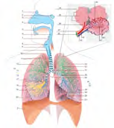
SYSTEMS
• Assembly of parts with structure, connectivity and behavior
• Modules that relate to each other
• Interacting entities with common goals
• Objects within defined boundaries within some environment
• Response to inputs from externalities
• Creation of outputs to externalities

Slide 25
EMBEDDED SYSTEM
A computer system specifically designed for a particular function
Combination of computer hardware and software
Hardware optimized for the application requirement
Software may be fixed or programmable

Slide 26
Introduction to software
Software can be thought of as the variable part of a computer and hardware the invariable part.
Software is often divided into application software (programs that do work users are directly interested in) and system software (which includes operating systems and any program that supports application software).

Slide 27
Operating System
An operating system is a program that acts as an interface between the user and the computer hardware and controls the execution of all kinds of programs.
Following are some of important functions of an operating System.
Memory Management Processor Management
Device Management File Management
Security Job accounting
System performance control Error detecting aids
Coordination between other software and users

Slide 28
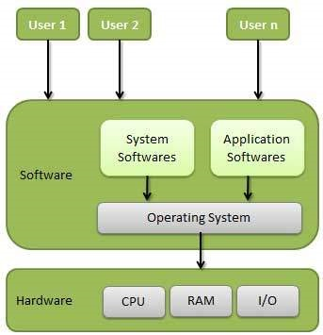
Operating System

Slide 29
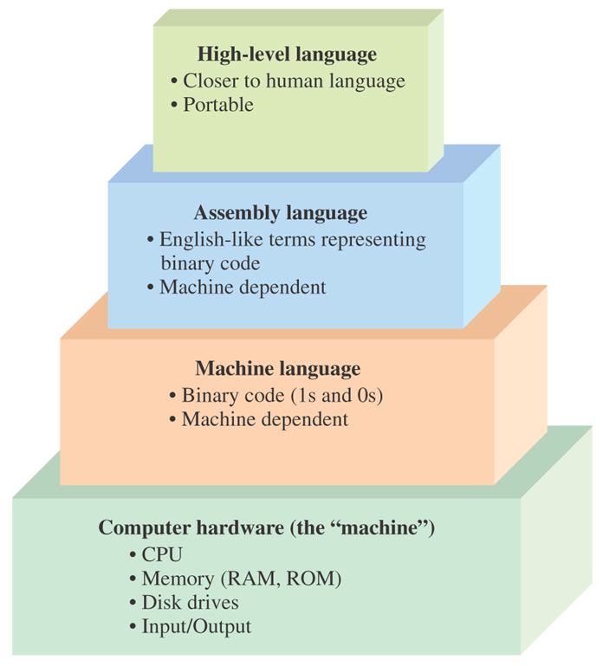
Hierarchy of programming languages

Slide 30
assembler
An assembler creates object code by translating assembly instruction mnemonics into opcodes, and by resolving symbolic names for memory locations and other entities.
The use of symbolic references is a key feature of assemblers, saving tedious calculations and manual address updates after program modifications.

Slide 31
compiler
A compiler is a computer program (or set of programs) that transforms source code written in a programming language(the source language) into another computer language (the target language, often having a binary form known as object code).
The most common reason for wanting to transform source code is to create an executable program.

Slide 32
INTERPRETER
An interpreter is a computer program that executes, i.e. performs,
instructions written in a programming language. An interpreter
generally uses one of the following strategies for program execution:
- Execute the source code directly
Example: Early versions of the Lisp and Dartmouth BASIC
- Translate source code into some efficient intermediate representation and immediately execute this
Example: Perl, Python, MATLAB, and Ruby
- explicitly execute stored precompiled code[ made by a compiler which is part of the interpreter system
Example: UCSD Pascal
- Some systems, such as Smalltalk, contemporary versions of BASIC, Java and others may also combine two and three.

Slide 33
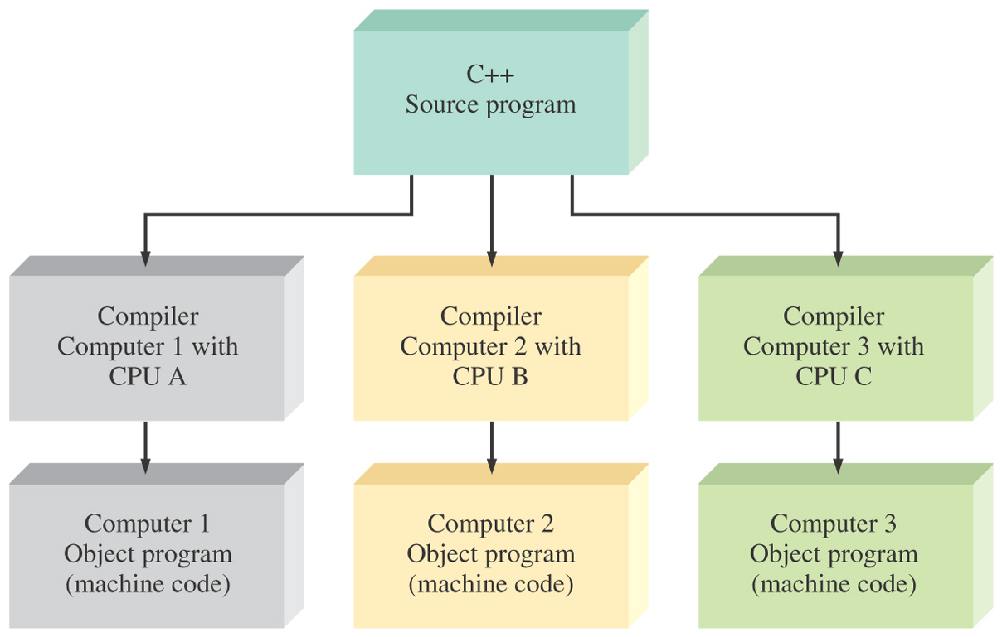
Machine independence of a program

Slide 34
Programming
Programming is the process of taking an algorithm and encoding it into a notation, a programming language, so that it can be executed by a computer. Although many programming languages and many different types of computers exist, the important first step is the need to have the solution. Without an algorithm there can be no program.

Slide 35
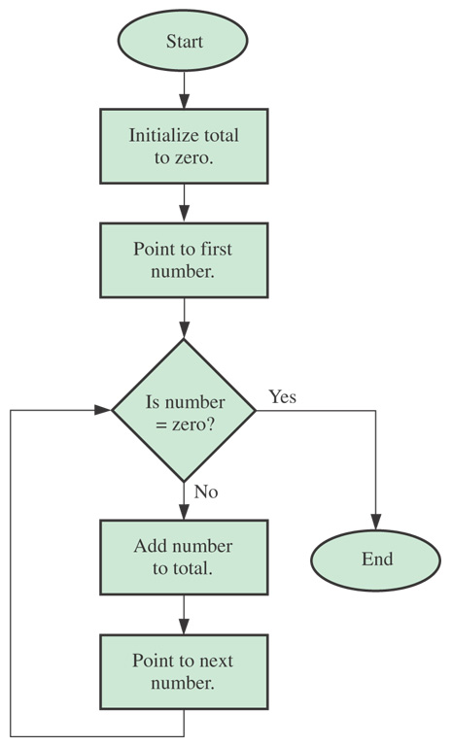
Flowchart - adding a list of numbers
The algorithm takes any number of non-zero numbers and gives the total. The process stops when a zero is encountered

Slide 36
Introduction to wired and wireless communication network
Wired communication refers to the transmission of data over a wire-based communication technology.
The cables can be copper wire, twisted pair or fiber optic.
Although the trend moves towards an increased use of wireless communication systems, wired systems are still as relevant as they have been.
Some examples of wired systems are cable TV, ADSL (broadband) and fixed telephony (PSTN - Public Switched Telephone Network), Wave Guide etc.

Slide 37
Wireless Network
"Wireless" refers to communication using radio waves or electromagnetic wave propagation
All the wireless devices will have antenna or sensors.
Typical wireless devices include cellular mobile, wireless sensors, TV remote, satellite disc receiver, laptops with WLAN card etc.
Basic networking concept is common for wired and wireless networks.

Slide 38
Local Area Network
A local-area network (LAN) is a computer network that spans a relatively small area.
Most often, a LAN is confined to a single room, building or group of buildings.
However, one LAN can be connected to other LANs over any distance via telephone lines and radio waves.

Slide 39
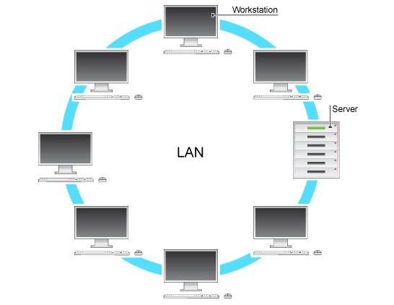
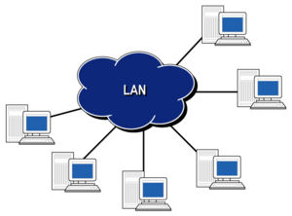
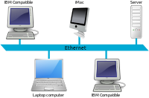
Local Area Network Topologies
Star
Ring
BUS

Slide 40
IEEE 802
IEEE 802 is a family of IEEE standards dealing with local area networks and metropolitan area networks.
More specifically, the IEEE 802 standards are restricted to networks carrying variable-size packets.
802.3 Ethernet Working Group
802.11 Wireless LAN Working Group

Slide 41
Local Area Network Protocols
There are many LAN protocols in use today.
Some of the more common ones are Ethernet, Asynchronous Transfer Mode (ATM), Token Ring and Fiber Distributed Data Interface (FDDI).
Ethernet is a common LAN protocol that can be found in most organizations.

Slide 42
Wireless Local Area Network
A wireless LAN (or WLAN, for wireless local area network, sometimes referred to as LAWN, for local area wireless network) is one in which a mobile user can connect to a local area network (LAN) through a wireless (radio) connection.
The IEEE 802.11 group of standards specify the technologies for wireless LANs. 802.11 standards use the Ethernet protocol and CSMA/CA (carrier sense multiple access with collision avoidance) for path sharing and include an encryption method, the Wired Equivalent Privacy algorithm.

Slide 43
Common networking components
Hub
Switch
Bridge
Router
Gateway

Slide 44
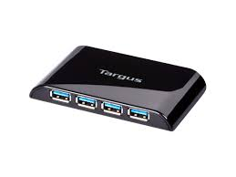
Hub
A hub is a common connection point for devices in a network. Hubs are commonly used to connect segments of a LAN. A hub contains multiple ports. When a packet arrives at one port, it is copied to the other ports so that all segments of the LAN can see all packets.

Slide 45
Switch
In networks, a device that filters and forwards packets between LAN segments.
Switches operate at the data link layer (layer 2) and sometimes the network layer (layer 3) of the OSI Reference Model and therefore support any packet protocol.
LANs that use switches to join segments are called switched LANs.

Slide 46
Routers and Bridges
Router forwards data packets along networks. It connects at least two networks, commonly two LANs or WANs or a LAN and its ISPs network.
A network bridge is a computer networking device that creates a single aggregate network from multiple communication networks or network segments. This function is called network bridging. Bridging is distinct from routing, which allows multiple different networks to communicate independently while remaining separate.

Slide 47
Gateways
A gateway is a network node connecting two networks that use different protocols
Gateways can take several forms -- including routers or computers -- and can perform a variety of tasks.
These range from simply passing traffic on to the next hop on its path to offering complex traffic filtering, proxies or protocol translations at various network layers.

Slide 48
Introduction to Control Systems
Open - loop control
Where output is not fed back to input
Close - loop control
Where output is not fed back to input

Slide 49
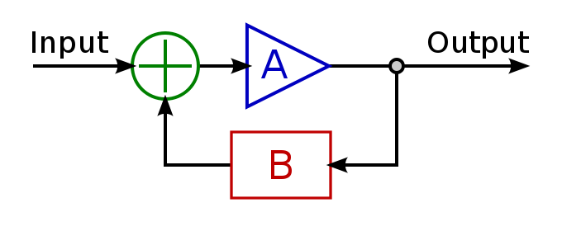
Feed-Back Control System
Basic Feed-Back Control

Slide 50
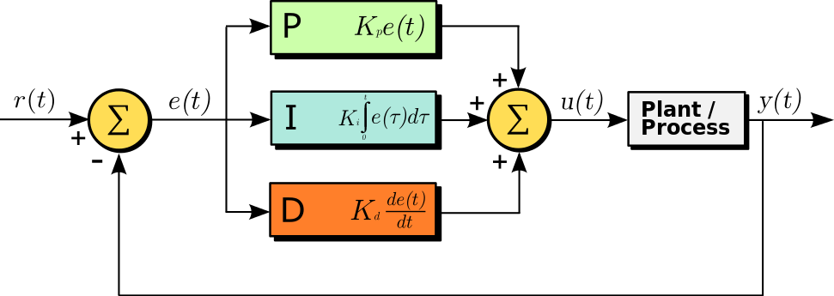
PID Control System

Slide 51
ON/OFF Control
As its name implies, On-Off Control assigns the Controller Output (CO) to one of two positions such that the final control element (FCE) is either fully open or fully closed. Unlike intermediate value or PID control, there is no in between. Most industrial processes require greater latitude when it comes to adjusting the COs position.

Slide 52
Logic Control
Logic control uses digital electronics and programming for implementation
Logic gates, microprocessors/microcontrollers and sometimes complete computer systems are building blocks for implementing control logic.
Special languages or notations like ladder logic are used in Programmable Logic Controllers
Modern systems use tools and applications based on standard computer languages like C/C++/JAVA
Control using fuzzy logic considers in-between values between true (1) and false (0). Fuzzy logic is based on the basis of a measurement being partially true.

Slide 53
Digital Control

Slide 54
Model Predictive Control
Model Predictive Control (MPC) is a multivariable control algorithm that uses:
- an internal dynamic model of the process
- a history of past control moves and
an optimization cost function J over the receding prediction horizon
to calculate the optimum control moves.

Slide 55
Introduction to Data Acquisition Systems (DAQ/DAS)
Data acquisition (DAQ) is the process of measuring an electrical or physical phenomenon such as voltage, current, temperature, pressure, or sound with a computer. A DAQ system consists of sensors, DAQ measurement hardware, and a computer with programmable software.
Compared to traditional measurement systems, PC-based DAQ systems exploit the processing power, productivity, display, and connectivity capabilities of industry-standard computers providing a more powerful, flexible, and cost-effective measurement solution.

Slide 56
Building Blocks of Data Acquisition Systems

Slide 57
Sensors
The measurement of a physical phenomenon, such as the temperature of a room, the intensity of a light source, or the force applied to an object, begins with a sensor.
A sensor, also called a transducer, converts a physical phenomenon into a measurable electrical signal.
Depending on the type of sensor, its electrical output can be a voltage, current, resistance, or another electrical attribute that varies over time. Some sensors may require additional components and circuitry to properly produce a signal that can accurately and safely be read by a DAQ device.

Slide 58
Common Sensors
Phenomenon/property | Sensing element
Temperature | Thermocouple, RTD, Thermistor
Sound | Microphone
Force and Pressure | Microphone Strain Gauge, Piezoelectric Transducer
Light | Photo Sensor
Position and Displacement | Potentiometer, LVDT, Optical Encoder
Acceleration | Accelerometer
pH | Electrode

Slide 59
Analog to Digital Converter (ADC)
An electronic integrated circuit which transforms a signal from analog
(continuous) to digital (discrete) form.
Analog signals are directly measurable quantities
Digital signals only have two states.
For digital computer, we refer to binary states, 0 and 1.

Slide 60
Why ADC?
Physical phenomena are all analog in characteristics
Computers and controllers can only perform complex processing on digitized signals.
When signals are in digital form they are less
susceptible to noise.
ADC Provides a link between the analog world of transducers and the digital world of signal processing and data handling

Slide 61
Application of ADC
ADC are used virtually everywhere where an
analog signal has to be processed, stored, or
transported in digital form.
Some examples of ADC usage are digital volt
meters, cell phone, thermocouples, and
digital oscilloscope.
Common ADC are 8, 12, or 16 bit ADCs,

